Slide 1
Reduce!
Efficient use of resourcing for preserving the planet heritage

Slide 3
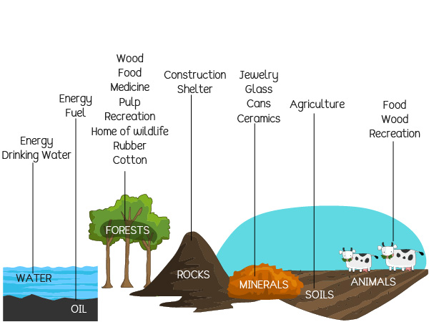

Slide 4
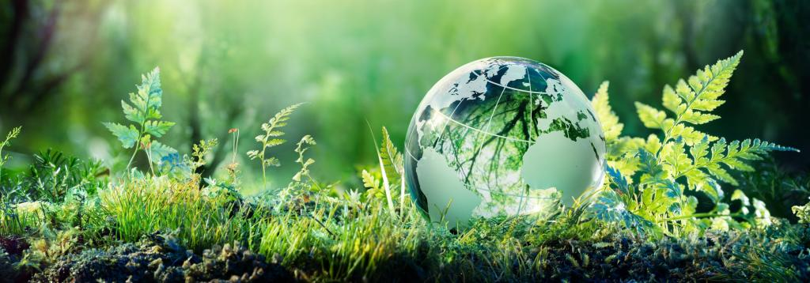
- essential for the appropriate life development, but under what costs?

Slide 5
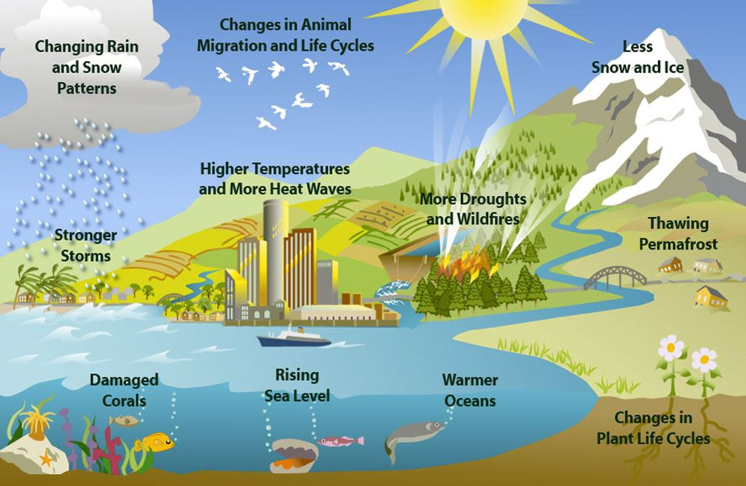

Slide 6
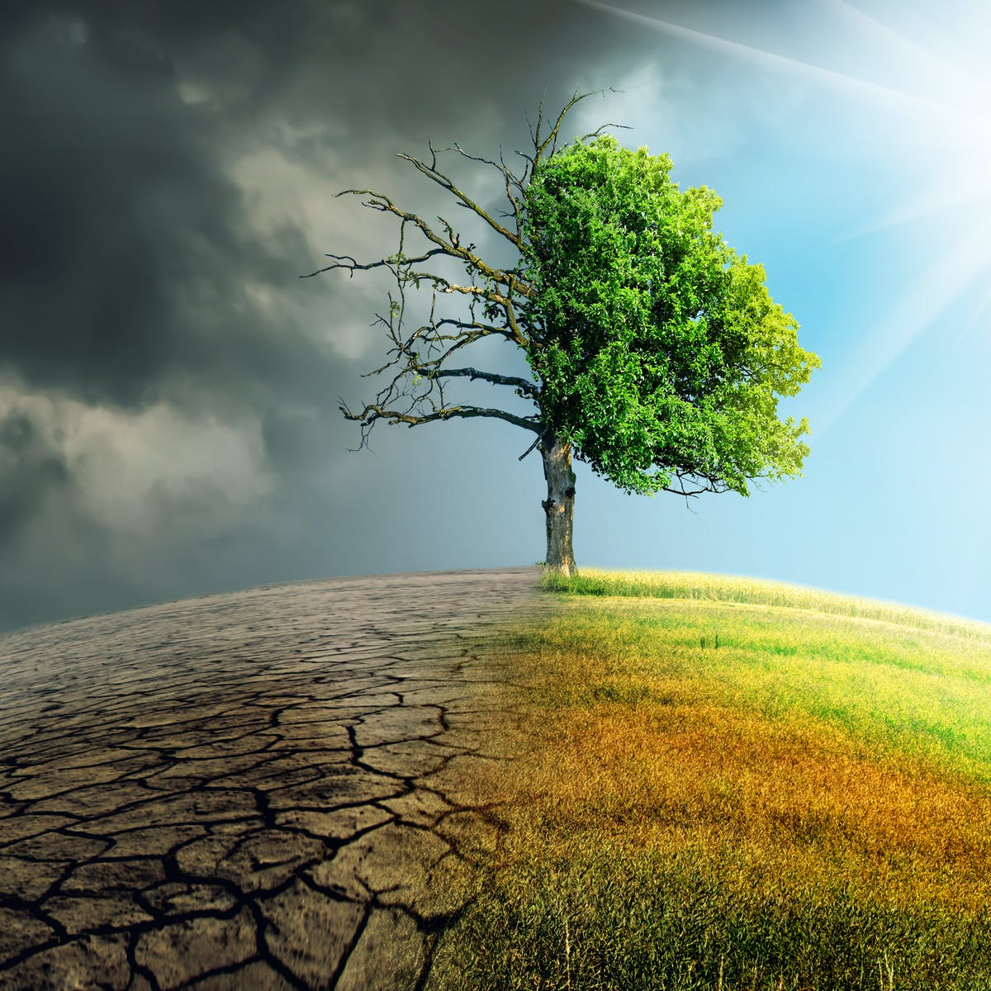
CONSERVATION =?
SCARCITY =?
DROUGHT =?

Slide 7
conserve water
pay attention to everything you USE at home/work/school daily
introduce solar power/wind power to produce energy
reduce the amount of electricity
you use
walk/ ride a bike instead of using a car
use less water when brushing/having a shower
turn off the things you don’t use
use sunlight instead of artificial light

Slide 8
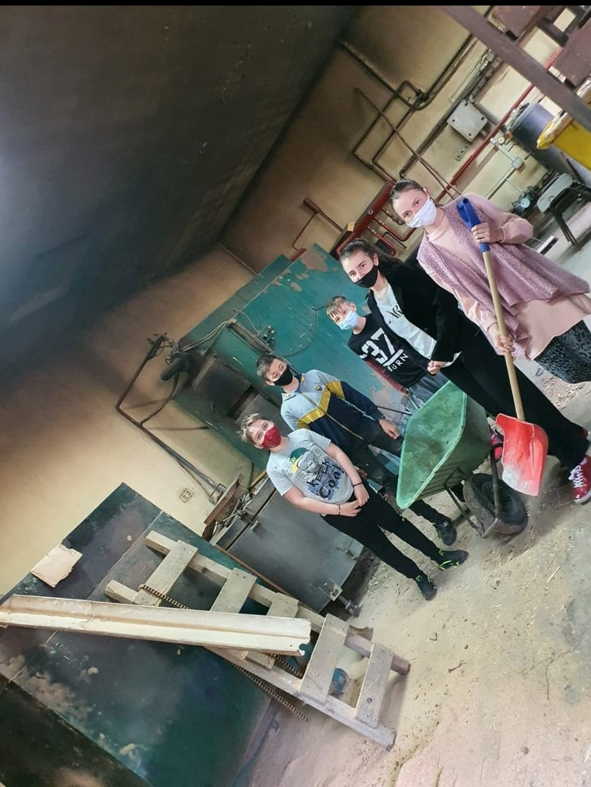
An example of
good practice:
The heating system
of the school
– from sawdust
(forestry exploitation
waste)

Slide 9
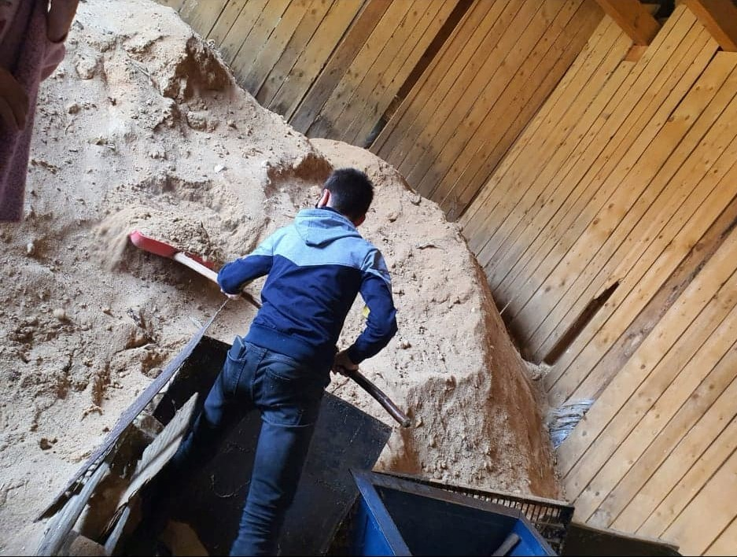

Slide 10
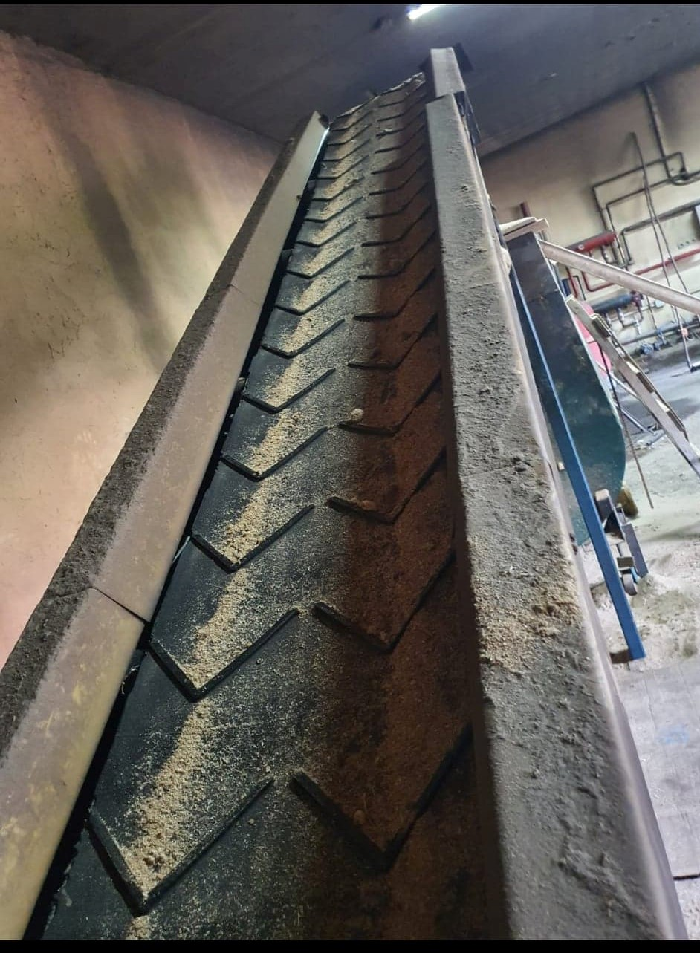

Slide 11
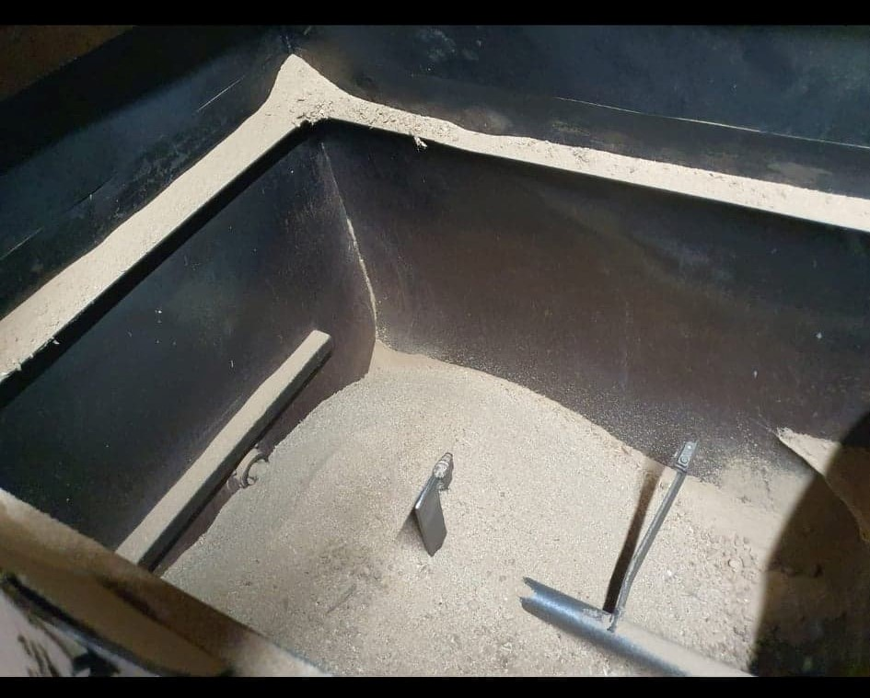

Slide 12
Natural resources can be part of our natural heritage or protected in nature reserves.
2 important nature reserves in our county:
Orheiu Bistritei forest with the motley tulip – protected species
Colibita Lake - natural habitat of Vipera Berus, a type of protected viper in Romania

Slide 13
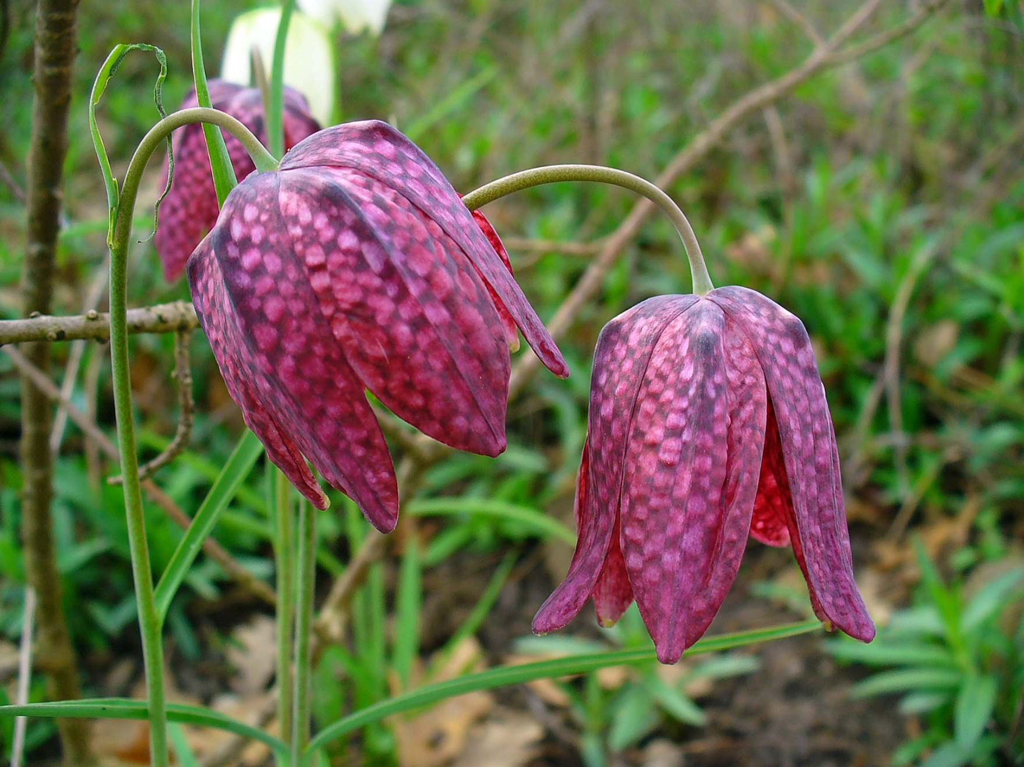

Slide 14
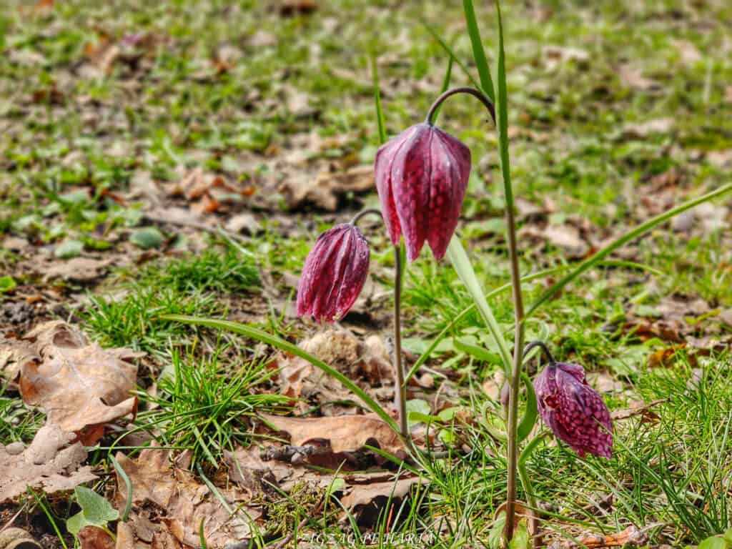
The motley tulip from Orheiu Bistritei forest
Fritillarea Meleagris in Latin
fritillus which in Latin means chessboard,
alludes to the neat,
reddish-brown squares
of the tulip
height
between 15 - 40
centimeters
- blooms
between
March and May,
only in a few
areas all over
the Europe
needs a humid
environment
to bloom in

Slide 15
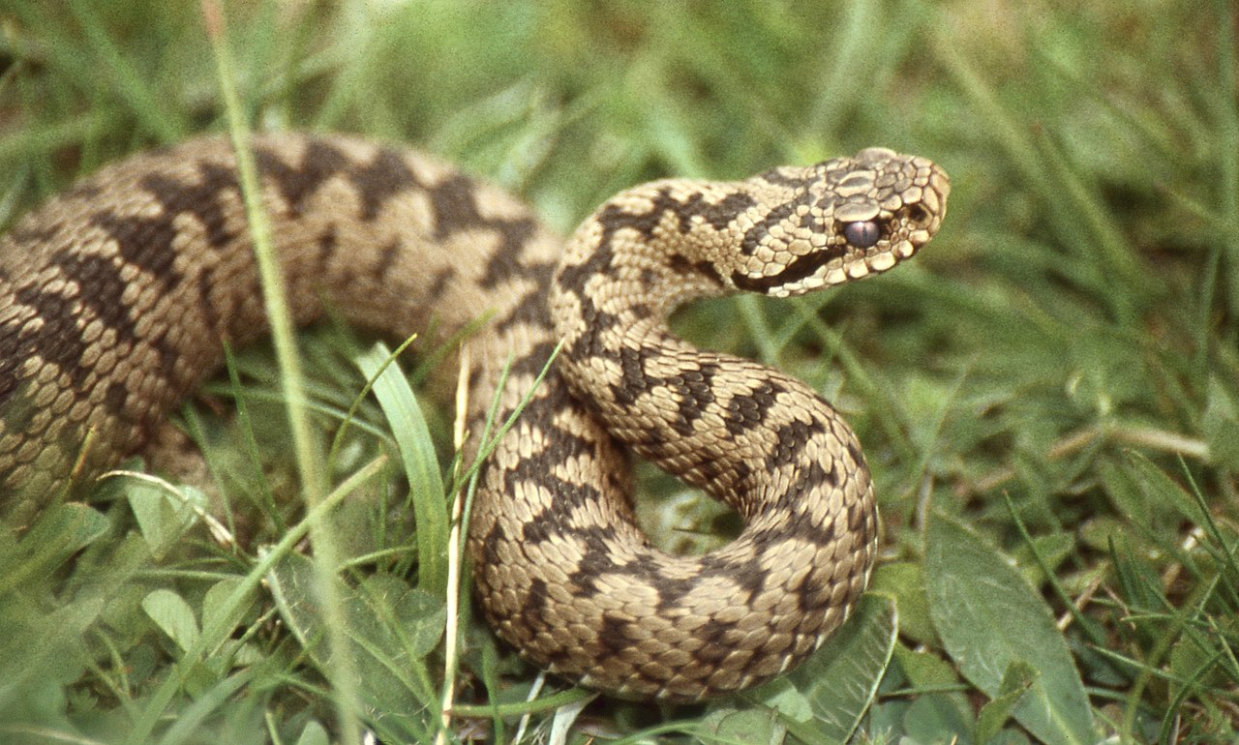
Colibita Lake - natural habitat of Vipera Berus, a type of protected viper in Romania

Slide 16
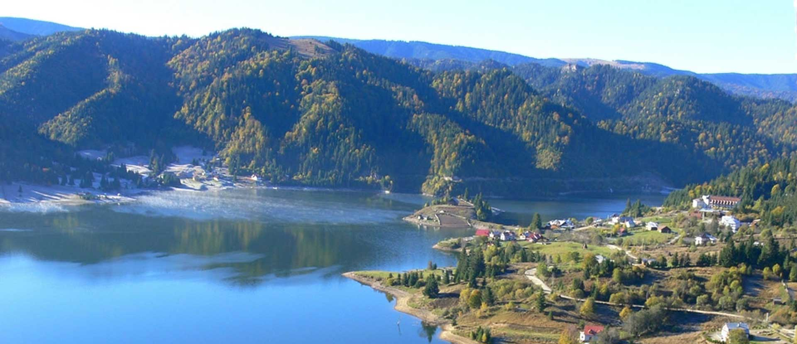
Colibița Lake
The dam
created between 1977 and 1991 for hydropower purposes along the Bistrita Bargaului River and manages to supply the surrounding area with water.
also known as “the sea from the mountain” or “the place with the cleanest air in Romania”, Colibita is an oasis of peace and joy

Slide 17
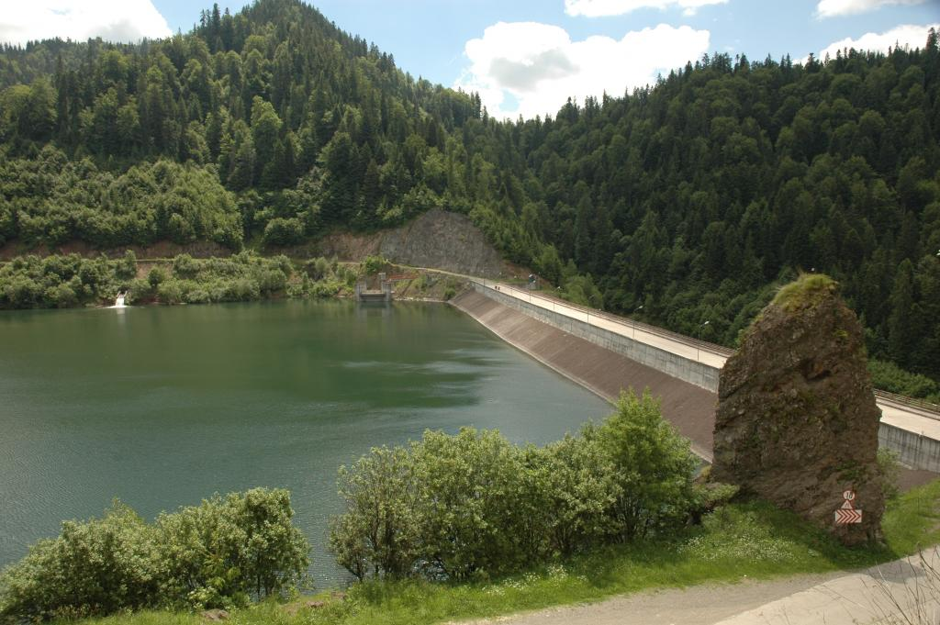
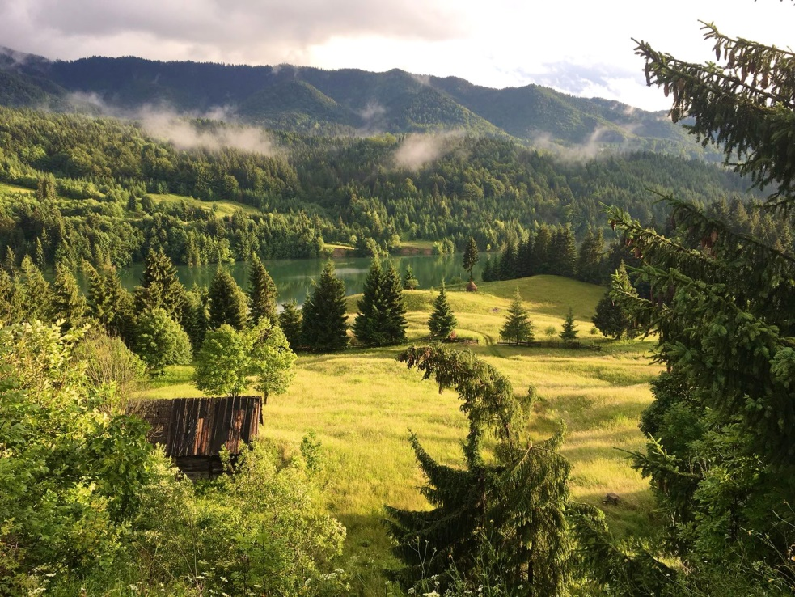
Colibita is an artificial
accumulation lake (man-made lake)
Legend of the lake
The lake was built where a small
village used to be. The few locals (some stories
say there were only 14) refused to move.
This is why they say you can still see the
houses and the cross of the church
when the water level drops to low.
Another legend says
there are monster fish in the
lake, and this is because the
locals were forced to move
and nature takes its revenge.

Slide 18
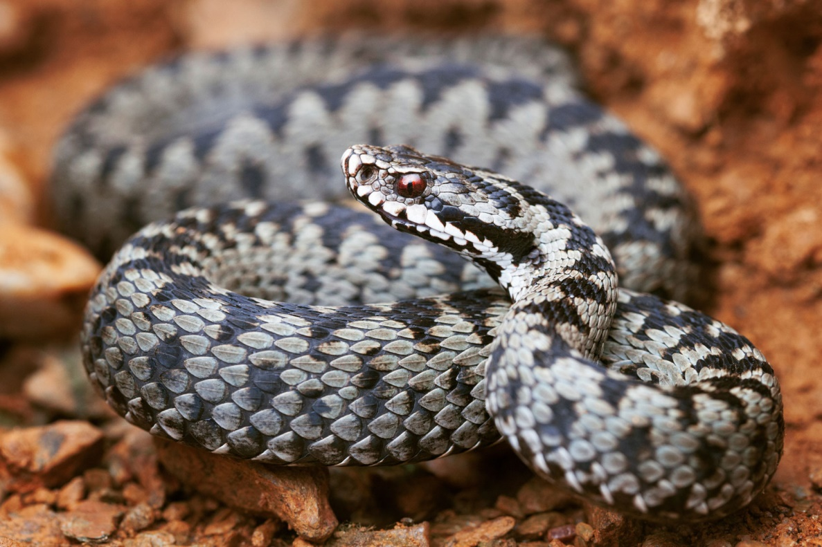
Vipera berus
length: 50-70 cm
color: from a gray-silver color to yellow, reddish, gray-brown to black
active during the day
2-3 times more
venomous than the rattlesnake, but it is not as dangerous due to its small venom reservoir (10-18 mg)
its bite can become
severe in children and in
the elderly.

